Slide 1





Boiled eggs 1 plate
Customer request
IO (DB/File)
Blocking Model

Slide 2
Boiled eggs 1 plate
Waiting
Waiting
Blocking Model

Slide 3

Waiting
Waiting
Blocking Model

Slide 4

Waiting
Waiting
Blocking Model

Slide 5
Non Blocking Model

Slide 6
Boiled eggs 1 plate
Customer request
node
IO (DB/File)

Slide 7
Boiled eggs 1 plate
Waiting
Non Blocking Model

Slide 8
Non Blocking Model

Slide 9
Non Blocking Model

Slide 10
Non Blocking Model

Slide 11

Non Blocking Model

Slide 12

Non Blocking Model with Child Process- fork
Child processes

Slide 13
Cluster
Load balance with Cluster or PM2

Slide 14

http-proxy
Load balance with Virtual host
(Nginx)

Slide 15
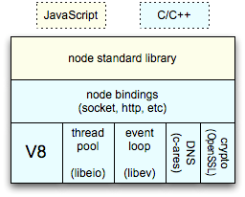
Node Architecture
Javascript
C++
C

Slide 16
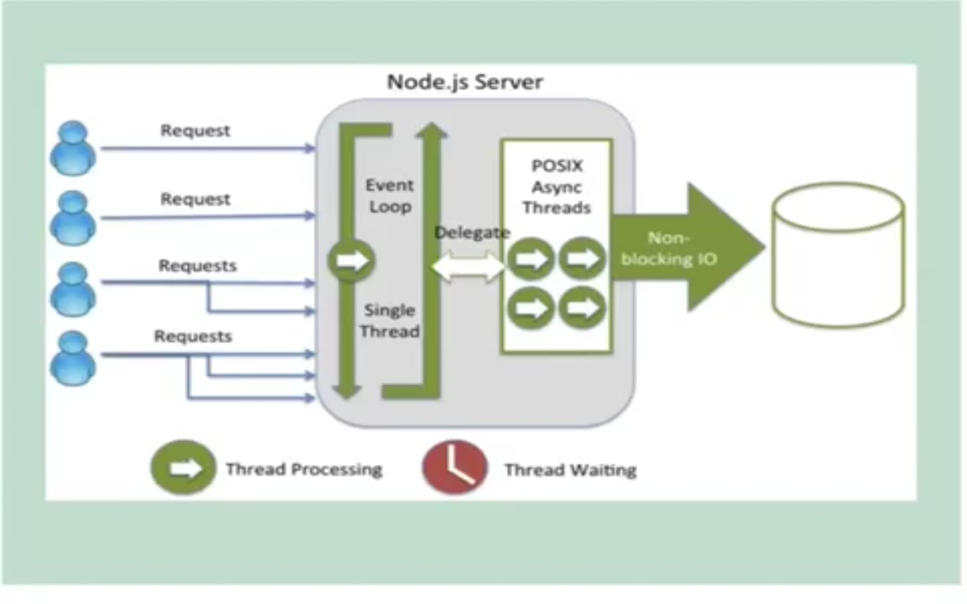
Node Architecture

Slide 17
How node Works?
NODE – Google V8 Engine (Process)
DB
Callback
request
request
data
close
….
Libuv
Libio
Socket
Thread
Pool
response
File
Event Loop
(nexttick)
Event Emitter
Single Thread

Slide 18
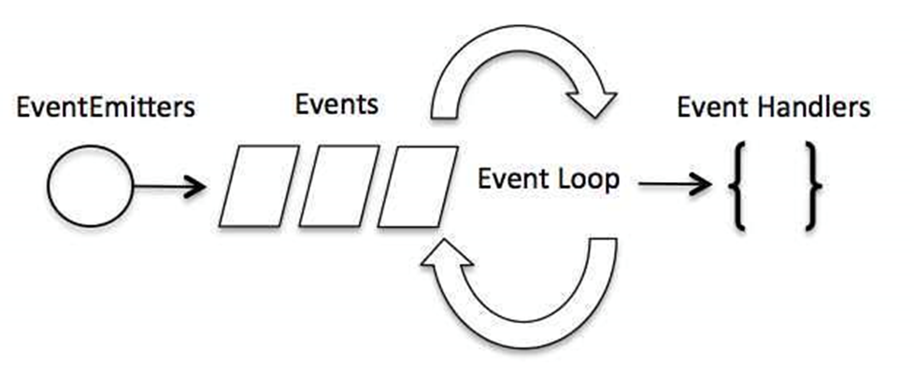
Event Loop
Node uses observer pattern.
Node thread keeps an event loop and whenever any task get completed, it fires the corresponding event which signals the event listener function to get executed.

Slide 19
How event Loop works in browser?
How node Works?
$.on('button',
'click',function(e){
setTimeout
(function timer(){
console.log
('clicked button')
},2000);
});
console.log
('do something');
Callstack
Web Events or Node Events
$.on(‘button’),’click’…
Execute code
setTimeout(function..)
setTimeout(function..)
Callstack Queue
Click Event
Click me
timeout Event

